Slide 1

Don’t Fear Custom Clang Tools

Slide 2
Summary
What is Clang Tooling
Killer App 1: Large Scale Refactoring
Killer App 2: Dead Code Elimination

Slide 3
What are Clang Tools
Standalone tools for C++ developers
Automatic Formatting
Refactoring
Checking
Requirement: Code compiles with Clang
Just compiling with Clang found bugs in my code

Slide 4
It Compiles with Clang! What do I win
Clang Tidy
“An excellent C++ Linter”

Slide 5
It Compiles with Clang! What do I win
struct Base {
virtual void reimplementMe(int a) {}
};
struct Derived : public Base {
virtual void reimplementMe(int a) {}
};
clang-tidy -checks='modernize-use-override' demo.cpp

Slide 6
It Compiles with Clang! What do I win
struct Base {
virtual void reimplementMe(int a) {}
};
struct Derived : public Base {
virtual void reimplementMe(int a) {}
};
demo.cpp:5:17: warning: prefer using 'override' or (rarely) 'final' instead of 'virtual' [modernize-use-override]
virtual void reimplementMe(int a) {}
~~~~~~~~ ^
override

Slide 7
But Wait, There’s More. -fix
struct Base {
virtual void reimplementMe(int a) {}
};
struct Derived : public Base {
virtual void reimplementMe(int a) override {}
};
clang-tidy -checks='modernize-use-override' -fix demo.cpp -- -std=c+11

Slide 8

Maybe it just works and it’s awesome

Slide 9

Sometimes the real world is messy

Slide 10

Maybe you don’t care about overrides

Slide 11

Killer App: Large Scale Refactoring

Slide 12
Killer App: Large Scale Refactoring
void Car::add( Person *p )
{
...
}
void pack_for_vacation()
{
car->add( driver );
car->add( kid );
car->add( dog );
trailer->add( grandma );
}

Slide 13
Killer App: Large Scale Refactoring
void Car::push_back( std::unique_ptr<Person> p )
{
...
}
void pack_for_vacation()
{
car->add( driver );
car->add( kid );
car->add( dog );
trailer->add( grandma );
}

Slide 14
Killer App: Large Scale Refactoring
void Car::push_back( std::unique_ptr<Person> p )
{
...
}
void pack_for_vacation()
{
car->push_back( std::unique_ptr<Person>(driver) );
car->push_back( std::unique_ptr<Person>(kid) );
car->add( dog );
trailer->add( grandma );
}

Slide 15

Killer App: Dead Code Elimination

Slide 16
Dead Code Elimination
void Car::add( Person *p )
{
if ( type() == RENAULT && color() == BLACK )
{
do_case_1();
}
else {
do_case_2();
}
...
}

Slide 17
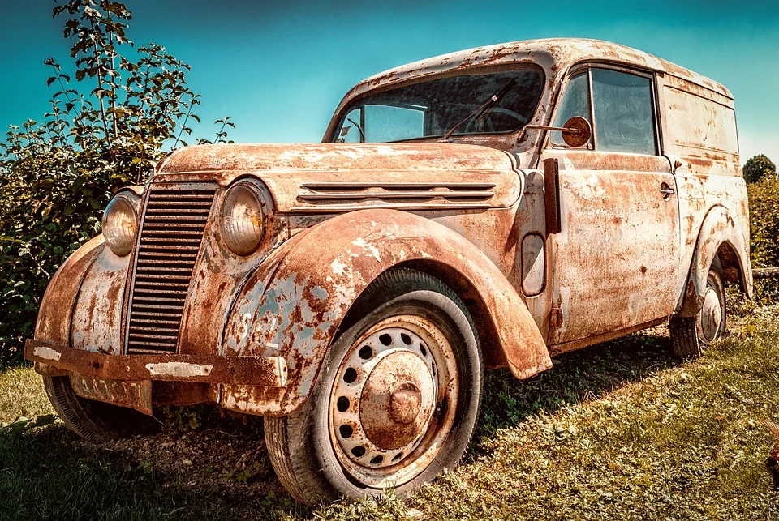
Renaults: Not Supported Anymore

Slide 18
Dead Code Elimination
void Car::add( Person *p )
{
if ( false && color() == BLACK )
{
do_case_1();
}
else {
do_case_2();
}
...
}
type() == RENAULT is always false
We do not support Renaults anymore

Slide 19
Dead Code Elimination
void Car::add( Person *p )
{
if ( false )
{
do_case_1();
}
else {
do_case_2();
}
...
}
false && expression is always false

Slide 20
Dead Code Elimination
void Car::add( Person *p )
{
{
do_case_2();
}
...
}
The if branch is trivially dead code

Slide 21
My Experience with Clang Tools
Tool #1 4 days dev time
Tool #2 4 hours dev time
Tool #3 2 hours dev time

